Slide 1
SLIIT · Group R26-IT-128
PathwayIQ
Progress Review 2

Slide 2
SLIIT · Group R26-IT-128
PP1 Feedback
PP1 Comment | How We Addressed It
Prioritize actual research logic over UI-level development. | Shifted focus to backend logic - transitioned from UI mockups to 4 fully functional Python microservices.
Focus on dataset preparation and model development. | trained/evaluated multiple ML models across all four modules, benchmarked and compared before final selection.
Demonstrate measurable technical progress in parallel. | Achieved verified accuracy metrics across all components - proven live in today’s demo.

Slide 3
SLIIT · Group R26-IT-128
Ecosystem
  One Ecosystem
  Skill Forecasting
  API Gateway
  Career Pathway
  4 Microservices
  CV Analyzer
  Live Data Flow
  Interview preparation

Slide 4
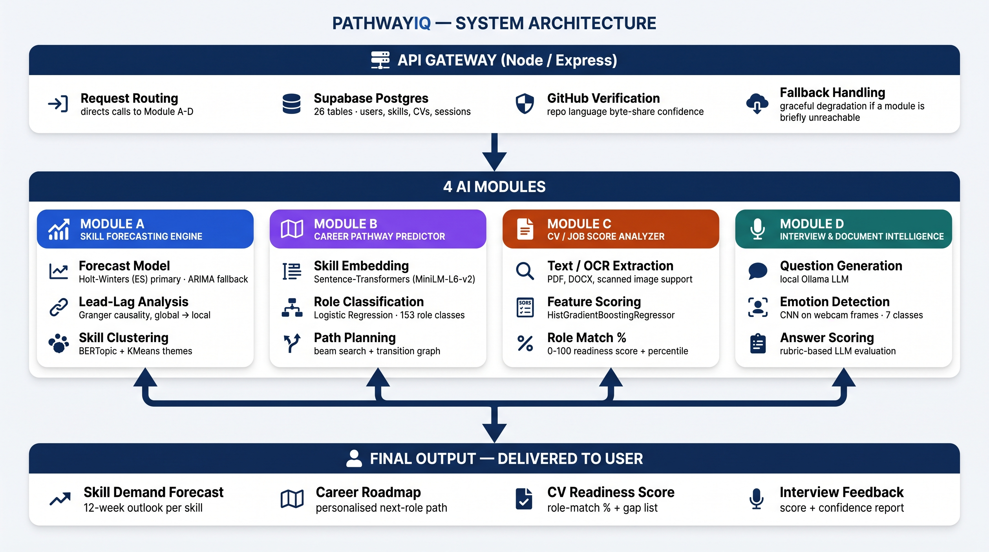
SLIIT · Group R26-IT-128

Slide 5
SLIIT · Group R26-IT-128
Milestones
Foundations
Algorithms
Transitioned from prototype to a working backend across all 4 components - forecasting, career prediction, CV scoring, and interview prep.
Each component runs its own model:
ARIMA/ES
Sentence-Transformers
HistGradientBoosting
CNNs

Slide 6
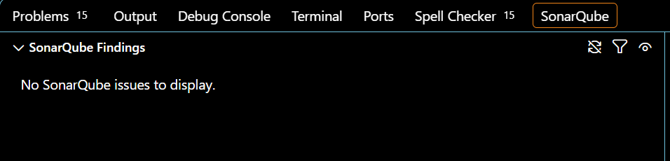
SLIIT · Group R26-IT-128
Professional Practices
Code Quality
Authentication
Static analysis via SonarQube reports zero code smells, bugs, or vulnerabilities across the codebase - verified ahead of deployment
Stateless JWT verification via Supabase Auth — every protected route validates the token's signature against Supabase's live JWKS endpoint before granting access.

Slide 7
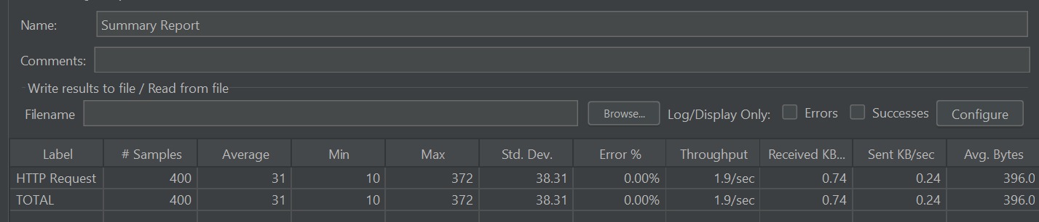
SLIIT · Group R26-IT-128
Professional Practices
Privacy
Reliability
CV structuring and interview generation run on a local Ollama LLM- zero reliance on external cloud APIs keeps user data fully private.
Stateless architecture supports scalability - load-tested via JMeter with a 0% error rate and ~31ms average response time.

Slide 8

SLIIT · Group R26-IT-128
Commercialization
Bridges the gap between academic curriculum and rapid industry shifts.
B2C: undergraduates get personalized, data-driven career roadmaps.
B2B: institutions optimize their syllabus using our 12-week market forecasts.

